Slide 1


National Diabetes Prevention Program (NDPP)
Community Health Workers (CHW)
Population Health Plan

Slide 2
National Diabetes Prevention Program (NDPP)
NDPP is based on a research study that demonstrated:
    - Adults at high risk for type 2 diabetes can prevent or delay the disease by 58% (71% if over age 60) by making modest lifestyle changes through a structured program.
Lifestyle coaches work with a group to help them reduce their risk of developing type 2 diabetes by:
    - Losing weight through healthy eating
    - Being more physically active
    - Learning to identify and address barriers to healthy eating and physical activity
  Even after ten years, those who participated had a 34% lower rate of type 2 diabetes.
DPP study, NEJM; Feb. 2002

Slide 3
Implementing NDPP in Maine
  1 in 3 Maine adults are at risk for type 2 diabetes
  For those with pre-diabetes who progress to diabetes, medical expenses are more costly
    Medical expenses for those with diabetes diagnosis on average 2.3 times more compared to those without diabetes
  Maine CDC is leveraging existing work that promotes use of NDPP in Maine –
    US CDC work plan activities related to diabetes prevention and control complement SIM work

Slide 4
NDPP Progress to Date
  Pre-SIM: 9 NDPP provider sites with 94 lifestyle coaches 2013
  With SIM: 13 provider sites with 114 lifestyle coaches 2014
  SIM work plan activities:
    May 2014 - Lifestyle coach training produced 20 new coaches
    November 2014 - NDPP Forum held to engage providers, payers, businesses

Slide 5
NDPP Moving Forward
SIM partnership to explore expansion and sustainability of NDPP
  Promote inclusion of NDPP as part of new multi-payer approaches
  Explore health plan payment for outcomes achieved with eligible populations; pay for completers of NDPP
  Integration within ACO/PCMH as a population health management strategy for people at high risk for Type 2 diabetes
Continue Lifestyle Coach Training and deployment with US CDC Recognized NDPP sites

Slide 6
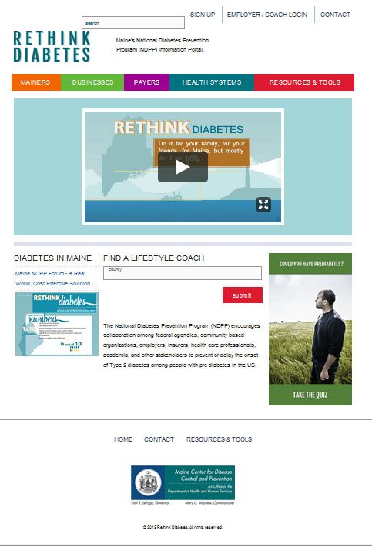
For More Information on NDPP…
  www.ReThinkDiabetes.org

Slide 7
Community Health Worker Initiative (CHW)
Definition of a community health worker:
Trained and trusted public health worker who is respected by the people they serve and applies his/her unique understanding of the experience, socio-economic needs, language and/or culture of the communities served to:
  Act as a bridge between providers and individuals to promote health, reduce disparities, and improve service delivery
  Advocate for individual and community needs

Slide 8
Community Health Workers
Contributions of CHWS:
  - Improving health outcomes
  - Supporting appropriate utilization of health care services
  - Increased cost savings
    Chronic disease support
    Cancer screening
    High risk or high consumers of health care services
Majority of studies showed net cost savings over 6 months to 2 years relative to control groups
Institute for Clinical Effectiveness and Review: http://cepac.icer-review.org/?page_id=1066

Slide 9


CHW Progress to Date: CHW Stakeholder Group
Informs CHW infrastructure and systems development
30 active members, 100 receive information
Core activities to date:
  Definition of community health worker (CHW)
  Core roles and responsibilities of a CHW
  Cross walk of roles and responsibilities to skills and attributes of CHWs
  Recommendations for recruitment of CHWs

Slide 10
CHW Progress to Date: Pilot Projects
4 pilots funded
  9 CHWs hired under project sites
  Geographic diversity/representation
  Trainings held Nov. 2014 - CHWs, supervisors
Focus on SIM priorities
  Individuals out of care/in need of medical home
  Individuals with chronic conditions
Triple Aim outcomes at pilot project level

Slide 11
CHW Moving Forward
Provide technical assistance and support for the 4 SIM CHW pilot sites
Support adoption and spread of CHW model through SIM pilots
Develop sustainability recommendation, including rationale and mechanism for payment/reimbursement of CHW services
Develop recommendations related to the process for certifying or registering CHWs, including identifying entities to do so

Slide 12

CHW Moving Forward
  www.mechw.org

Slide 13
Combined Future Successes
CHW
CHWs valued to provide culturally appropriate info and outreach
Adoption/integration of CHWs into care teams, community organizations
  Workforce model that fills emerging need in Maine/supports clinicians practicing at top of license
New payment structures include CHWs
NDPP
Health systems, businesses, and community organizations in Maine sustain NDPP Lifestyle Coaching and Program delivery system
Protocols in provider practices are incentivized to refer high risk eligible patients to NDPP, and support them being completers
New payment structures include NDPP delivery/completion

Slide 14
Population Health Plan
  Population health is defined as the health outcomes of a group of individuals, including the distribution of such outcomes within the group…it is understood that population health outcomes are the product of multiple determinants of health including medical care, public health, genetics, behaviors, social factors and environmental factors.
IOM Roundtable on Improving Population Health

Slide 15
Population Health Plan
Focuses on leveraging and aligning health transformation initiatives throughout the state and within communities to improve the health status of their population.
CMS Year 2 Guidance
Focuses to include:
  Diabetes, Obesity, and Tobacco Use
Due September 2016 to CMS

